Slide 1
Some DNS News
(August, 2018)
(And some nightmare)

Slide 2


Author:
Pablo Carboni
Twitter: @pcarboni
Mastodon: @pcarboni@bsd.network
SysAdmin, DNSAdmin, sometimes NetAdmin, sometimes Unix developer ☺.
Currently: DevOps at GraphPath.

Slide 3
What happened with DNS services during 2018?
New DNS services were offered for free by other companies, in addition to the offered by Google Public DNS (8.8.8.8/8.8.4.4).
There are additional protocols, with privacy and authenticity in mind that were added:
DNS-Over-TLS - standard RFC (DoT)
DNS-Over-HTTPS, draft IETF (DoH)
DNSCrypt (Open, no standarization)
Notes:
https://1.1.1.1/ -> Presentaciòn e info adicional del servicio provisto. .

Slide 4
New DNS service providers:
Focused on privacy
IPv4 and IPv6
This listing is partial.
(Additional services are available with other IPs)
“Quad9” (IBM- PCH - Global CyberAlliance)
DoT
9.9.9.9 / 149.112.112.122 [ IPv4 ]
2620:fe::fe, 2620:fe::9[ IPv6 ]
“1.1.1.1” (CloudFare - APNIC)
DoT, DoH
1.1.1.1 / 1.0.0.1 [ IPv4 ]
2606:4700:4700::1111 [ IPv6 ]
2606:4700:4700::1001 [ IPv6 ]
“CleanBrowsing” (CleanBrowsing)
DoT, DoH, DNSCrypt
185.228.168.168 / 185.228.169.168 [ IPv4 ]
2a0d:2a00:1::, 2a0d:2a00:2:: [ IPv6 ]
Notes:
PCH -> Packet Clearing House

Slide 5

DoH! (DNS over HTTPS)
DNS queries needs to be trusted (authenticity), and private (no spying), because of user security reasons.
However, this is not always as we wanted to have...
- For this purpose, in draft state, DNS over HTTPs (DoH), comes to rescue!

Slide 6
What’s DoH then?
What’s DoT?
- It’s DNS traffic travelling inside an encrypted transport like HTTPS.
- It enhances privacy and avoids data tampering. Avoid attacks like “Man-In-the-Middle” type.
Note: It doesn’t have mechanisms for querying to DNS authoritative servers.
Future standard: https://tools.ietf.org/html/draft-ietf-doh-dns-over-https-14
(Aug 16th, 2018)
- It’s DNS traffic travelling over a ciphered channel with TLS cryptographic protocol.
- It enhances privacy and avoid data tampering, trying to avoid attacks like “Man-In-the-Middle” type.
- RFC 7858 / RFC 8310

Slide 7





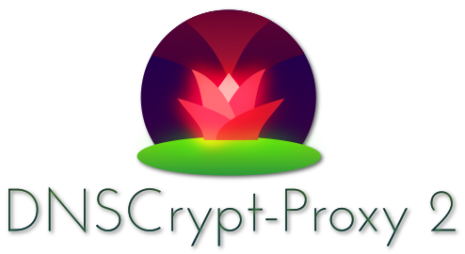
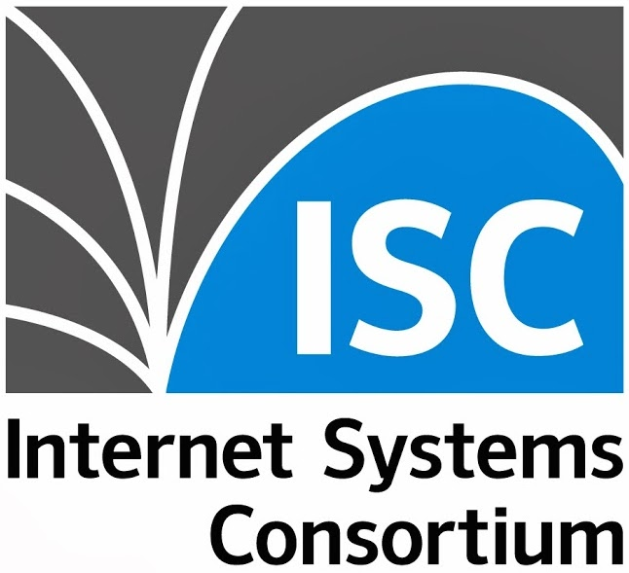


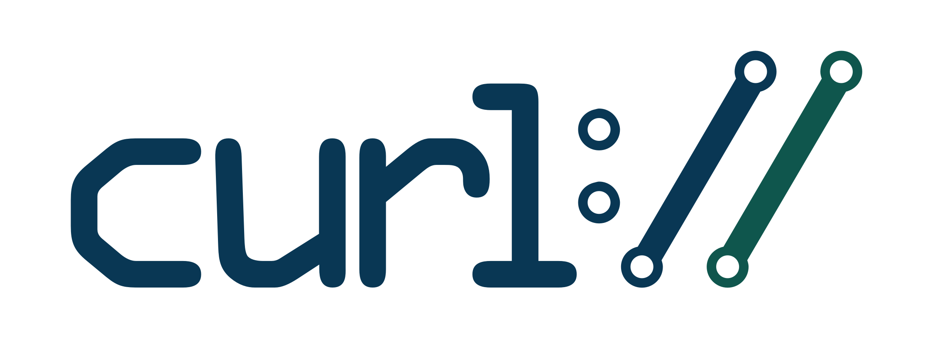



Some DoT implementations, both testing and production quality (August 2018)
Browsers: Firefox, Chrome, cURL.
Servers/Clients (DNS): Unbound, Bind, Knot
OS: systemd-resolvd 239 (Linux), Android 9 (Pie)
Services (companies): CloudFare, Quad9, CleanBrowsing
Proxies: DNSCrypt-Proxy (Frank Denis). LB: dnsdist (PowerDNS)
More info:
⇨ https://www.dnsprivacy.org (Main Hub with news, info about implementations, etc)
https://hacks.mozilla.org/2018/05/a-cartoon-intro-to-dns-over-https/
https://bitsup.blogspot.com/2018/05/the-benefits-of-https-for-dns.html

Slide 8


Some DoH implementations, both testing and production quality (August’2018)
Browsers: Firefox, Bromite (Chromium), cURL, OkHttp
Services (companies): CloudFare, CleanBrowsing, Google
Proxies: DNSCrypt-Proxy, client-server (Frank Denis), Facebook DoH client, jDnsProxy, Start Brilliant (client-server)
Note: There is no way to send queries to DNS authoritative servers.
More info:
https://github.com/curl/curl/wiki/DNS-over-HTTPS (Up-to-date implementations listing)
https://www.dnsprivacy.org (Main hub with news, implementations, etc)
https://en.wikipedia.org/wiki/DNS_over_HTTPS (Description from Wikipedia)

Slide 9

But … our world isn’t a perfect world …
Let’s imagine a world (2018 year) without DNS security running over the internet …
Are really enough those mechanisms descripted previously?
“The answer will not surprise you”
NO!(More protection is BETTER)

Slide 10

When the bad guys appear ...
What happens when someone access to a financial service, … but it isn’t what you supposed to be? (phishing)
What happens when your browser, suddenly says that your SSL (TLS) certificate isn’t VALID anymore? (unsigned)
(HTTPS validates signed certificates ... but nothing to do with hostname to ip mapping) - A trusted IP address.
That’s it ... Scams come to life!

Slide 11
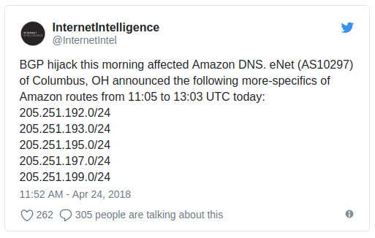
Hackers in action (1 of 2)
April 24th, 2018:
In a illegal way, fake BGP routes (prefixes) were published for DNS service, “Route 53” (AWS), affecting the service in a partial way, 1300 IPs roughly (BGP hijacking)
The attack - few hours -, had as final destination MyEtherWallet.com site, with DNS servers redirecting traffic to servers located in Russia.
Detail: Damage was about 150.000 USD. (215 ETHereum)
It should be noted that the DNS zone lacked DNSSEC support...
Fuente: https://doublepulsar.com/hijack-of-amazons-internet-domain-service-used-to-reroute-web-traffic-for-two-hours-unnoticed-3a6f0dda6a6f

Slide 12

DNSSEC to our rescue … (What’s its purpose?)
DNSSEC/DNS Security Extensions, are extensions to DNS protocol, that are meant to verify in a unique way thats answers from the DNS service are authentic, because there are signed zone/records (by using PKI).
It alse uses as mechanism, EDNS0 (DNS extensions to the original protocol).
There are some thoughts that says (because since its nature), is complementary to DoH/DoT.
Others, says that DNSSEC is not enough.
References:
https://blog.apnic.net/2018/08/17/sunrise-dns-over-tls-sunset-dnssec/
(Willem Toorop, NLnet Labs, Aug 17th 2018)
https://blog.apnic.net/2018/08/20/dnssec-and-dns-over-tls/
(Geoff Huston, APNIC, Aug 20th 2018)

Slide 13
Hackers in action (2 of 2)
DNS Rebinding attacks over IOT (Jun 19th, 2018, PoC). “TL;DR”
This kind of attacks affects a home network, generally speaking a WiFi network, by affecting mainly devices like TVs, Roku, Speakers, Routers WiFi, Thermostats(!), etc.
It consists in mapping DNS crafted records, in an ephemere fashion (low TTL for quickly changing destination IP), by using JS + POST on the objective.
References: https://medium.com/@brannondorsey/attacking-private-networks-from-the-internet-with-dns-rebinding-ea7098a2d325
Exploit report (thermostat):
https://cve.mitre.org/cgi-bin/cvename.cgi?name=CVE-2018-11315%29

Slide 14

https://dnsflagday.net/
IMPORTANT: February 1st, 2019, the following vendors:
BIND (ISC), Knot Resolver (CZ.NIC), PowerDNS, and Unbound (NLnet Labs)
Will remove workarounds from their software, for broken EDNS0 implementations, making that timeouts will valid only for network issues - and not for broken implementations.
Presentation at DNS-OARC 28, by Ondrej Sury (Internet Systems Consortium), Peter van Dijk (PowerDNS), Petr Špaček (CZ.NIC), Ralph Dolmans (NLnet Labs)
Slides:https://indico.dns-oarc.net/event/28/contributions/515/attachments/490/799/Removing_EDNS_Workarounds.pdf
Video: https://youtu.be/9YYH8JFH_bY?t=5198

Slide 15

Finally...
Happy 35th birthday DNS!
First Test, June/1983
RFC 882, First RFC with DNS description, November/1983

Slide 16
Acknowledgements:
(Alphabetic order):
Asian Pacific Network Information Centre (RIR) / www.apnic.net
CZ.NIC (NIC de República Checa) / www.nic.cz
DNS-OARC / www.dns-oarc.net
DNSCrypt-Proxy / Frank Denis
Internet Software Consortium / www.isc.org
NLNet Labs / www.nlnetlabs.nl
PowerDNS / www.powerdns.com
Sinodun Internet Technologies / http://www.sinodun.com

Slide 17
Thank you!

